Slide 1
Delivering Mission Critical Communications
Jithin Joyson
Tanwir Lalani
Sainath Macharla
Christopher Morcom

Slide 2
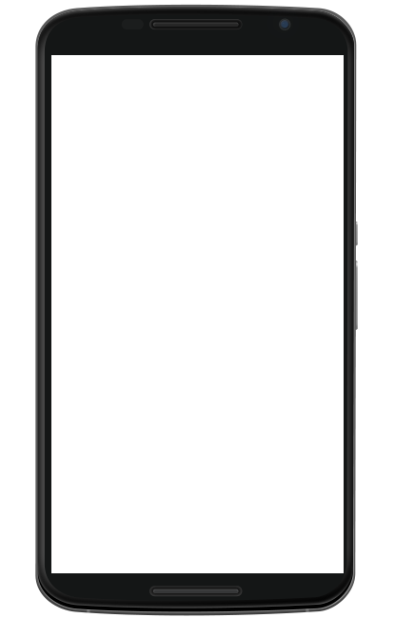
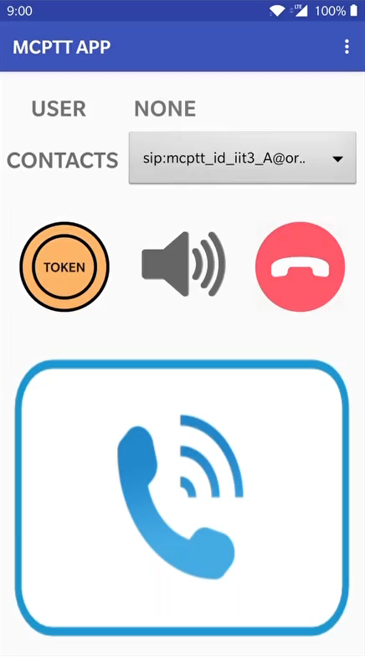
HOME SCREEN
Menu
User
Contacts
Buttons
Token
Speaker
Hang-up
Make Call
Message Toast

Slide 3
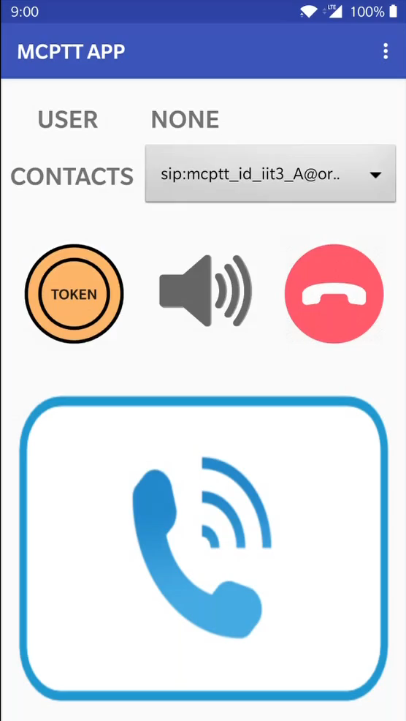
CALL FUNCTION
Register
Background Indicator
Message Indicator
User & Contacts Update
Call
Call Update
Token Update (Floor Control)

Slide 4
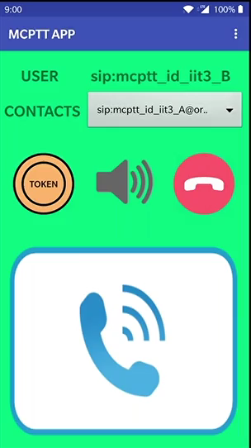
LOG FUNCTION
Incident List
Create a Log
Description
Type
Location
Dynamic Update
Recency Sorting
Voice Translation
Completion Tag
Deletion

Slide 5
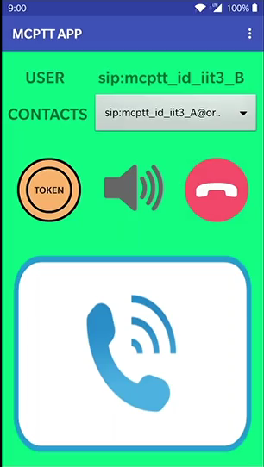
LOCATION FUNCTION
Real Time Tracking
Multiple User Viewing
Navigation
Google Maps

Slide 6
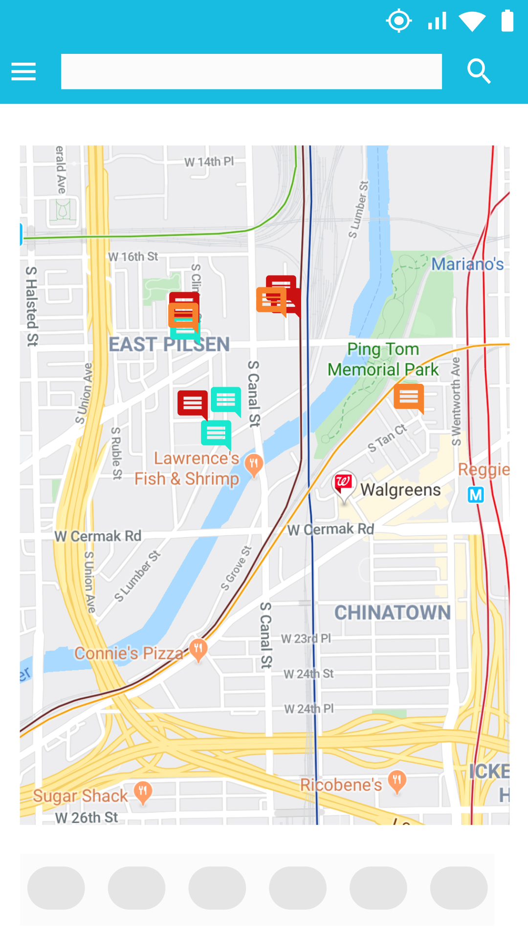
FUTURE UPDATES
Location Search
Location Identification
Call Priority
Video Streaming
9-line Access
Intra Group Communication
Communication via Relays
Messaging
Social Media Scanning
Iot Device Control

Slide 7




CRITERIA ASSESMENT
Criteria
Basic Requirement
Effectiveness
Appearance
Usability
Creativity

